Slide 1
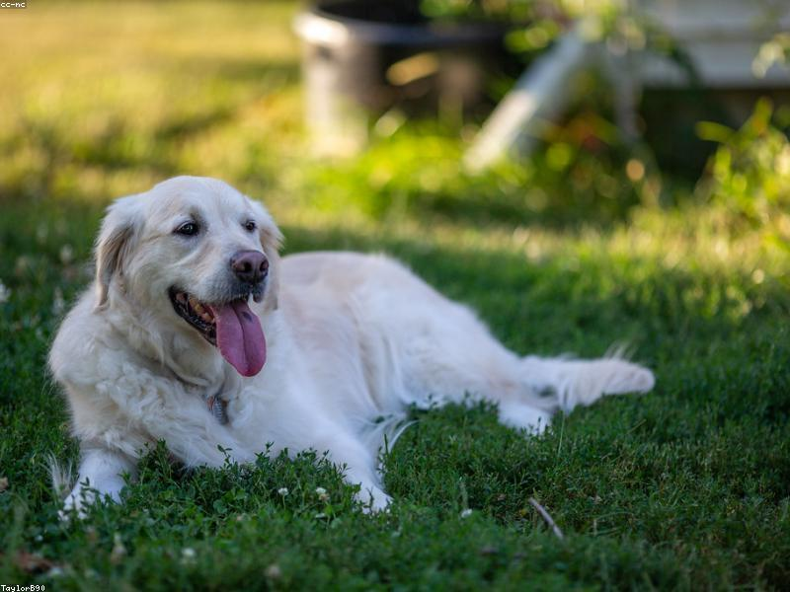
Popular Dog Breeds
- Labrador Retriever: Friendly and outgoing.
- German Shepherd: Intelligent and versatile.
- Golden Retriever: Loyal and friendly.
- Bulldog: Calm and courageous.
- Beagle: Curious and friendly.

Slide 2
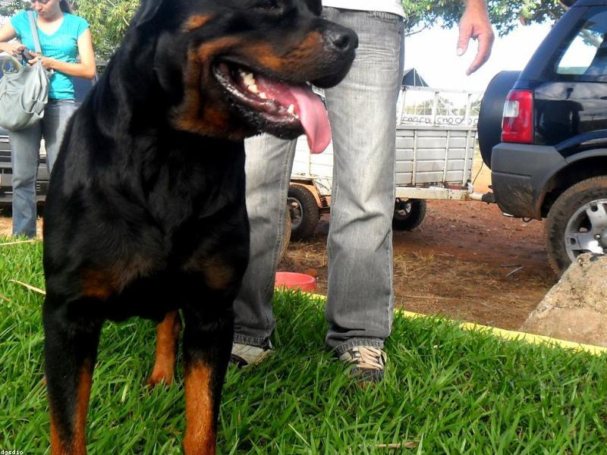
Working Dog Breeds
- Siberian Husky: Energetic and resilient.
- Boxer: Playful and loyal.
- Rottweiler: Confident and fearless.
- Doberman Pinscher: Alert and loyal.
- Great Dane: Gentle giant and friendly.

Slide 3
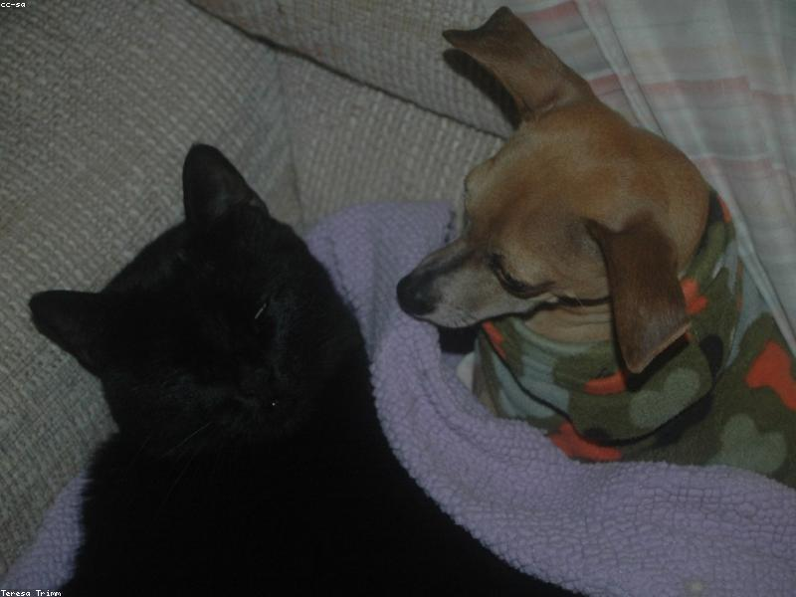
Toy Dog Breeds
- Chihuahua: Lively and alert.
- Pomeranian: Playful and friendly.
- Yorkshire Terrier: Spirited and brave.
- Maltese: Gentle and playful.
- Shih Tzu: Affectionate and outgoing.

Slide 4
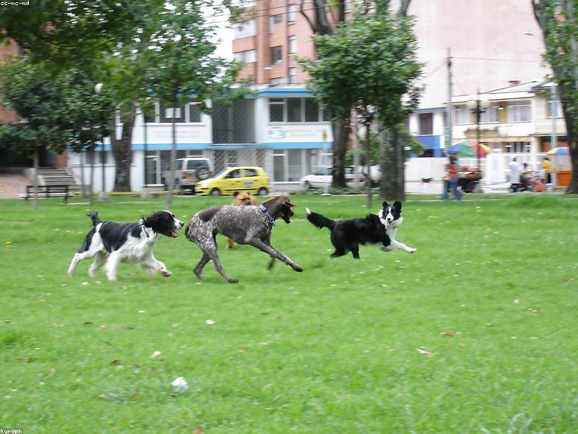
Sporting Dog Breeds
- Cocker Spaniel: Gentle and affectionate.
- English Springer Spaniel: Energetic and friendly.
- Weimaraner: Intelligent and energetic.
- Pointer: Energetic and alert.
- Vizsla: Loyal and affectionate.

Slide 5

Hound Dog Breeds
- Basset Hound: Laid-back and friendly.
- Bloodhound: Curious and friendly.
- Dachshund: Clever and courageous.
- Greyhound: Gentle and affectionate.
- Whippet: Friendly and playful.

